Slide 1

Real World RAG and RGB
by
Group-2 (Year:2025)
(Rahul, Bhanu, Sridhar and Santosh)
Proj.Supervisor: Dr.Manish Srivastava
Mentors: Gopichand and Lokesh

Slide 2
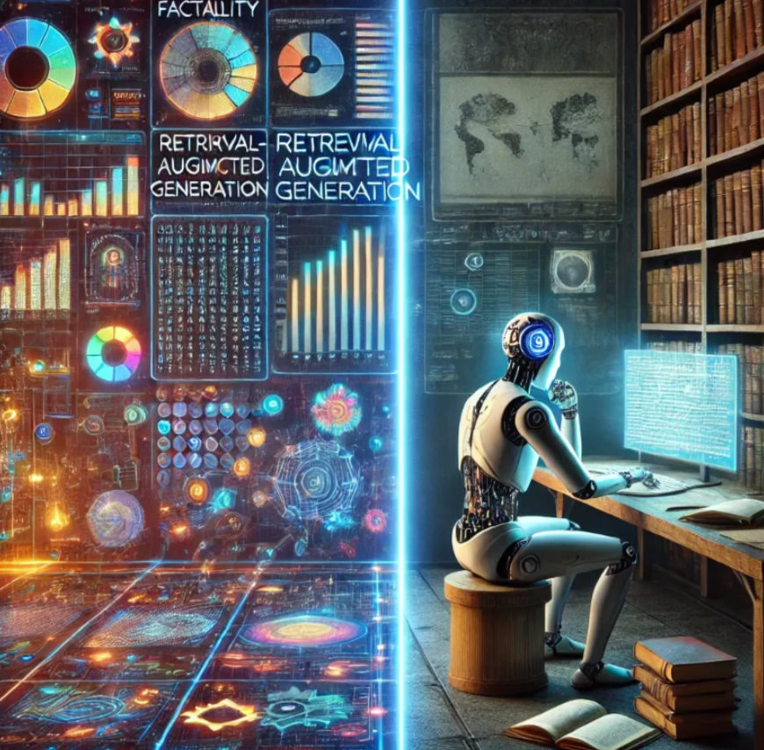
Retrieval-Augmented Generation (RAG)

Slide 3
Other llm tried were GPT 30 mini and T5
12 datasets
Ranking (BM25)
Response LLM (Mistral, QWEN)
Evaluation LLM (Deepseek)
Evaluation Metrics
(Utilization, Relevance, Adherence, and Completeness)
Embedding
(Sentence Transformer miniLLM built on BERT)
Chunking (fixed 5 sentences)
Sentence structuring (0a…)
Vector database (Chroma DB)

Slide 4
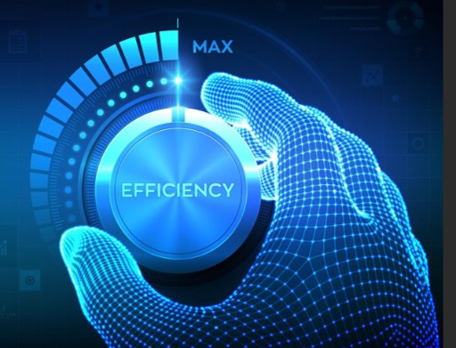
LLM selection criteria for RAG
Cost
Performance
Real time free API calls LLM using HF
GPT 3 o mini was fastest
Chat GPT OpenAI 3 o mini incurred token cost
Free API based llm are slower and had to use all GPU

Slide 5
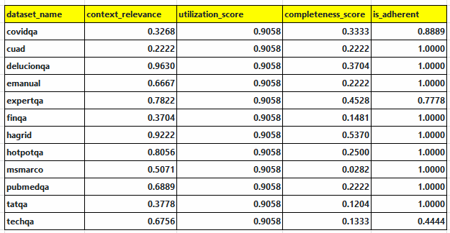
RAG Evaluation Metrics.aluatioetrics (RAG)MetrMe

Slide 6
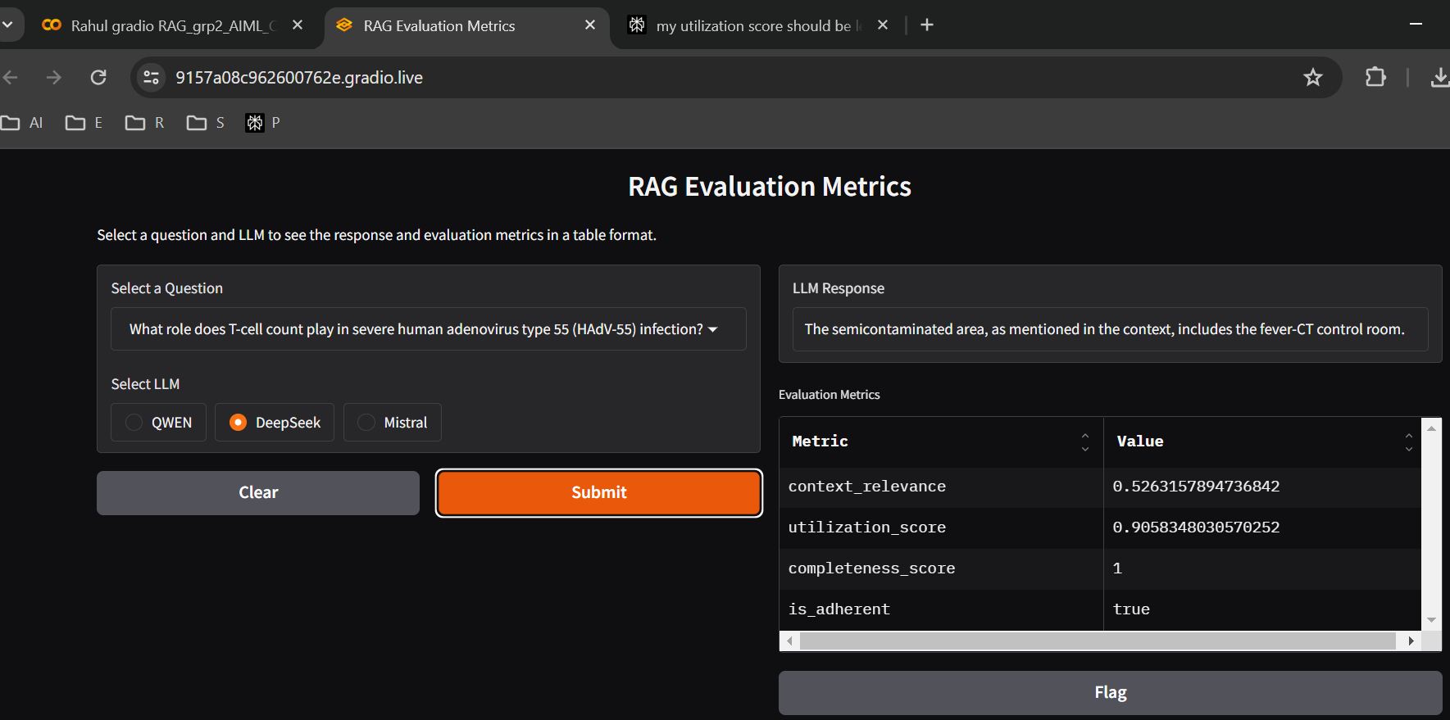
Deployment and Live Demo
https://74dc79e35209d85cd5.gradio.live/

Slide 7

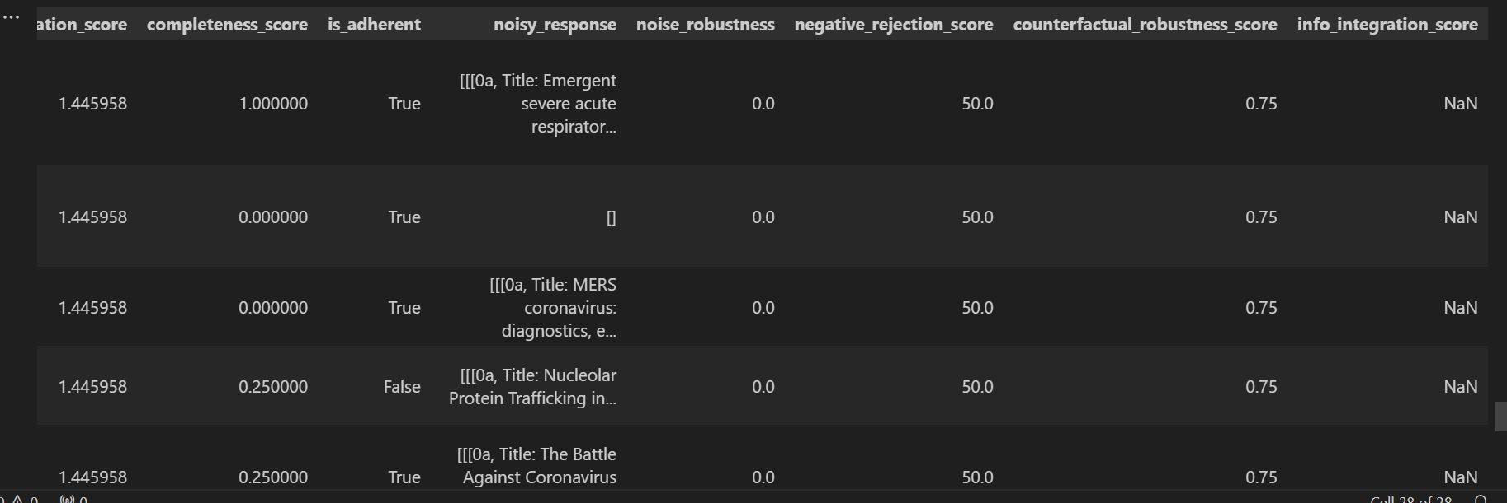
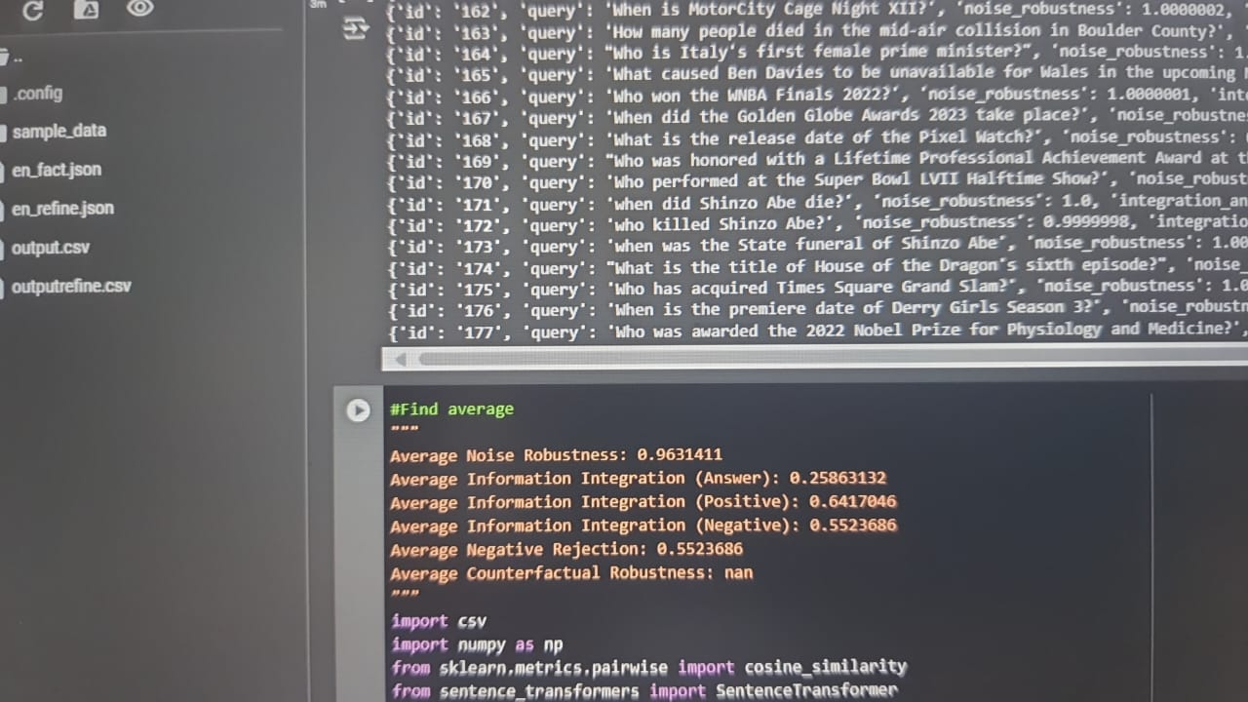
More metrics

Slide 8
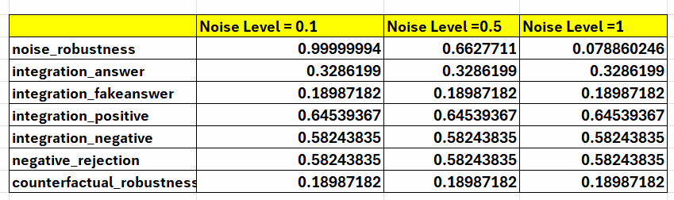
Evaluation metrics (RGB)
Noise Robustness: LLMs' ability to filter out irrelevant data.
Negative Rejection: Ability to reject answers when no useful data is found.
Information Integration: Ability to synthesize information from multiple documents.
Counterfactual Robustness: Identifying and dealing with incorrect or biased retrieved information.

Slide 9
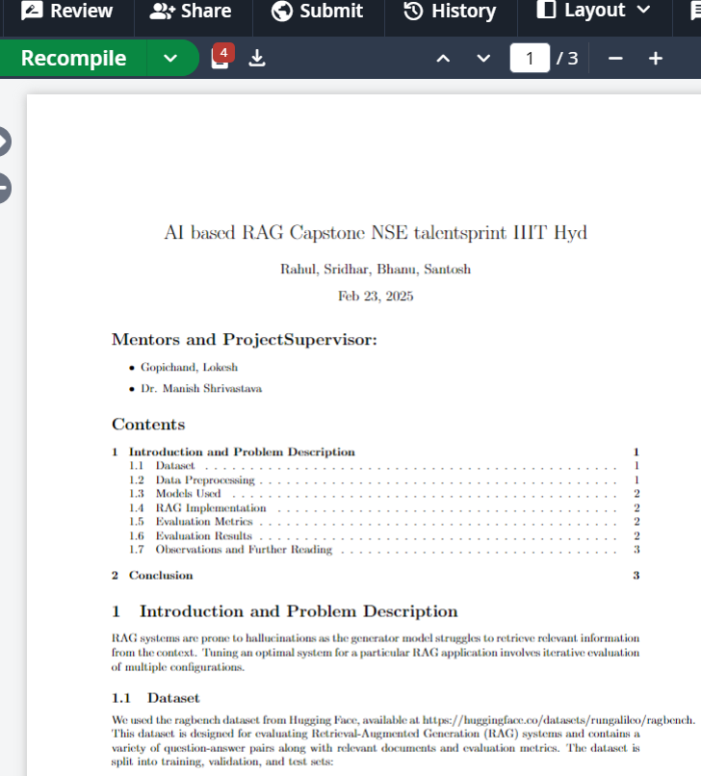
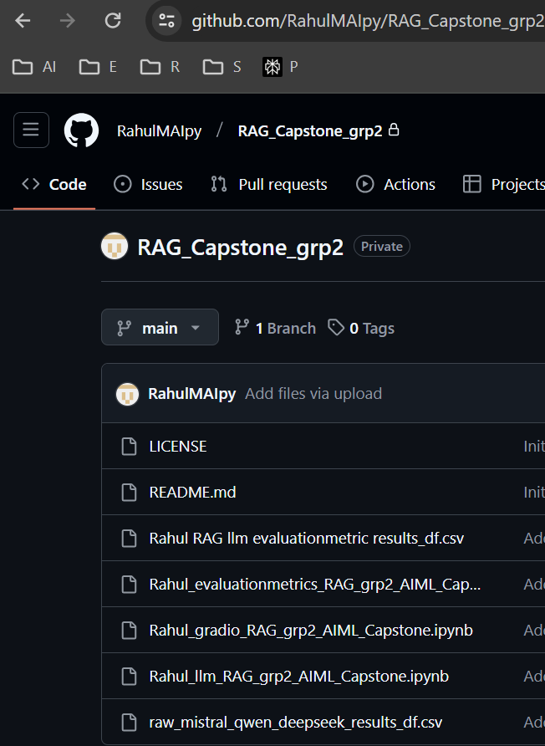
GitHub and Overleaf
https://github.com/RahulMAIpy/RAG_Capstone_grp2
https://www.overleaf.com/project/67aaca67d2796a5394b0dd92

Slide 10
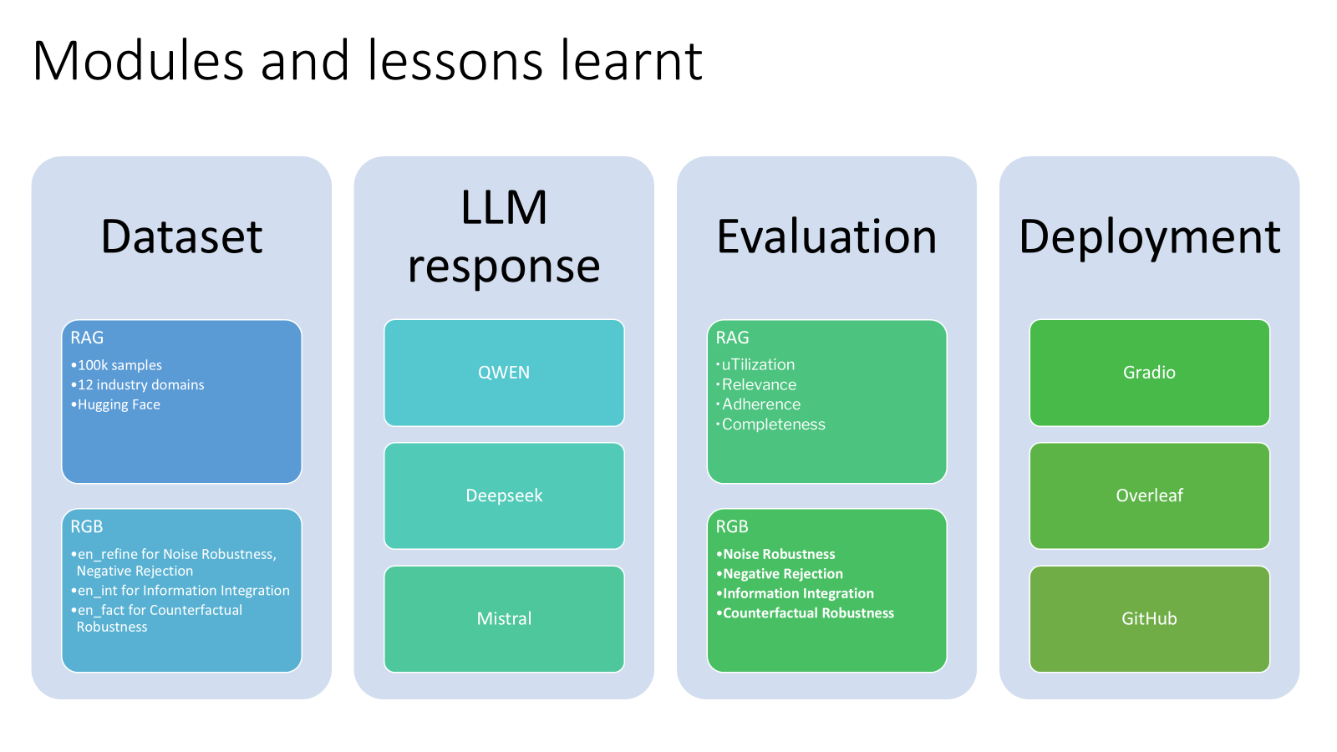
Modules and lessons learnt
Dataset
LLM response
Evaluation
Deployment
100k samples
QWEN
Noise Robustness
Gradio
Negative Rejection
12 industry domains
Deepseek
Overleaf
Information Integration
Hugging Face
Mistral
GitHub
Counterfactual Robustness

Slide 11
Thank you so much

